Slide 1
Distillation
Zion Steiner
Green AI group

Slide 2
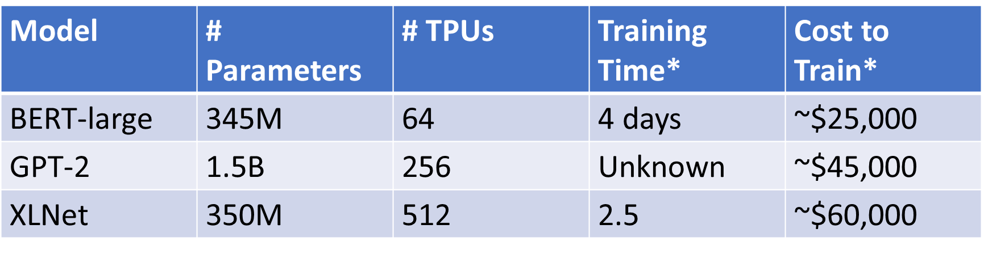
Motivation
High costs of NN
Notes:
(WHY)
State-of-the-art neural networks are using exponentially more parameters and larger data sets than in the past. Today’s best deep NN take about 300,000x more computing resources (petaflops/s*day) than they did in 2012. The result is an increasingly large machine learning carbon footprint. For example, the best version of AlphaGo costs $1000/hr to run. As marginal improvements to accuracy are coming at increasingly large costs, it’s essential to consider efficiency as an evaluation criterion for NN research going forward.

Slide 3
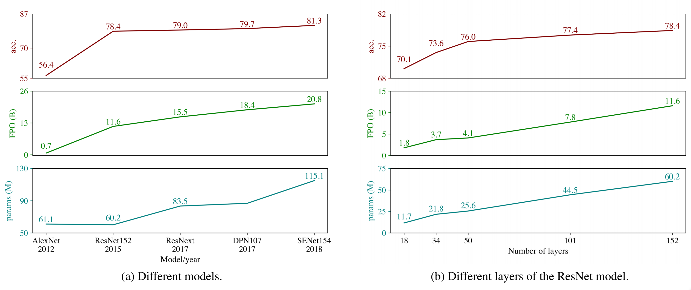
Motivation
Decreasing returns to scale
Notes:
As these graphs show, increases in model size and processing requirements are met with logarithmic increases in accuracy. At what point do we stop improving? We need to establish a framework for quantifying the cost of neural networks and a value-system for determining if increases in accuracy merit the cost.
These models are not feasible for widespread consumer deployment or mobile usage either.

Slide 4
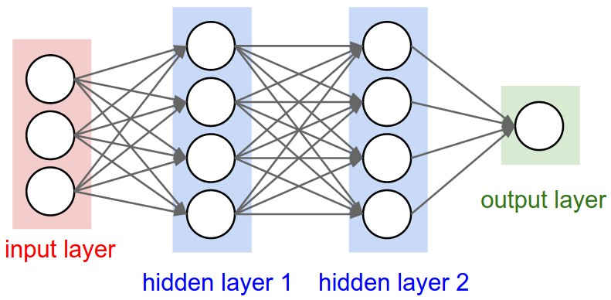
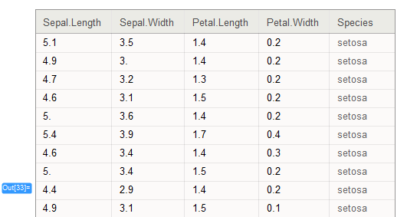
Three Aspects of Efficiency
3. Tuning Efficiency
2. Dataset Efficiency
Sepal length | Sepal width | Petal length | Petal width | Species
5.1 | 3.5 | 1.4 | 0.2 | setosa
1. Single Example Efficiency
Notes:
(WHAT)
The Green AI paper identifies three areas for improving efficiency in NN: single example processing, many example processing, and tuning. Improvements at lower levels flow upwards.
Single example: can we reduce the cost of training/inference associated with a single example?
Many examples: can we do more with less?
Many experiments: can we narrow potential configurations down?
I will be focusing on reducing single-example costs.

Slide 5
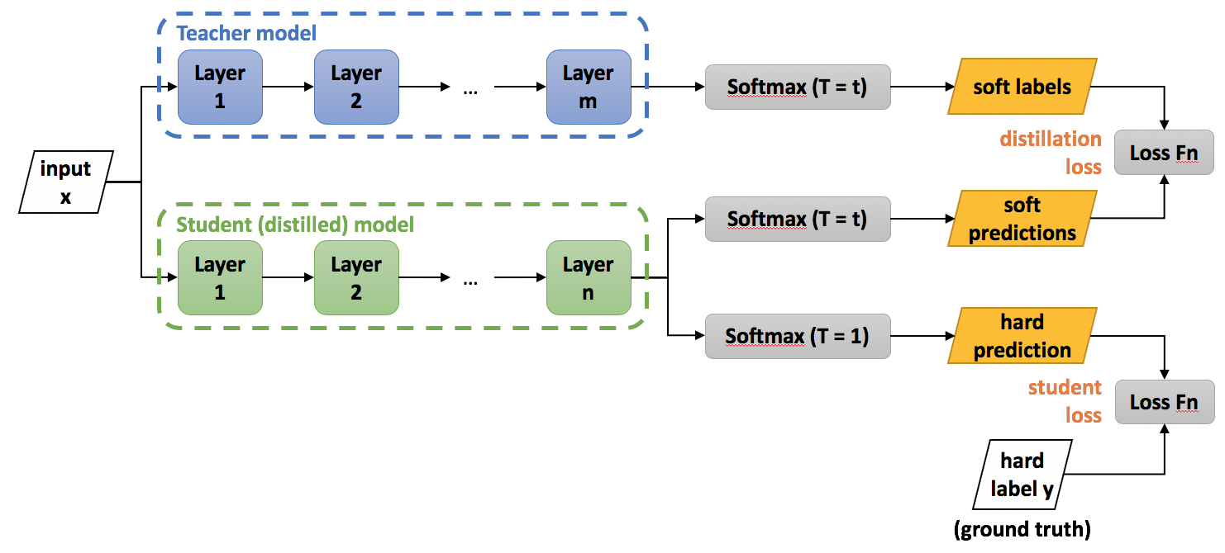
Potential Methods
Distillation
Compression
Weight pruning
Quantization
Hoffman Encoding
Notes:
(HOW)
Distillation is a method for training a smaller model based off of the learned generalizations from a larger model. It can be used to “distill” the information from a complex model into a model that can be run using smaller computing resources (mobile). This is also called a teacher-learner model.
Compression is a technique for reducing the memory requirement of storing and running a neural network.
Pruning: removes weights with negligible values
Quantization: given n-bits to represent a weight, generate 2^n clusters and assign each weight the value of its cluster’s centroid. Weight updates are aggregated and applied to all grouped weights. This reduces the precision of each weight, but significantly reduces the number of bits required to store each weight.
Hoffman Encoding: assigns small-valued codes to common values and larger-valued codes to rare values. It’s a common compression technique that can be applied to NN.
Image source: https://towardsdatascience.com/knowledge-distillation-simplified-dd4973dbc764

Slide 6
Distillation
Notes:
The assumption distillation is based on is that the “knowledge” learned by a teacher NN can be transferred to a student NN. This is accomplished by training the student NN to approximate the logits (output before softmax) of the teacher model. This works because the relative values of these logits with respect to class contains information on how the teacher generalizes between classes.
We train the student using a hybrid loss.

Slide 7
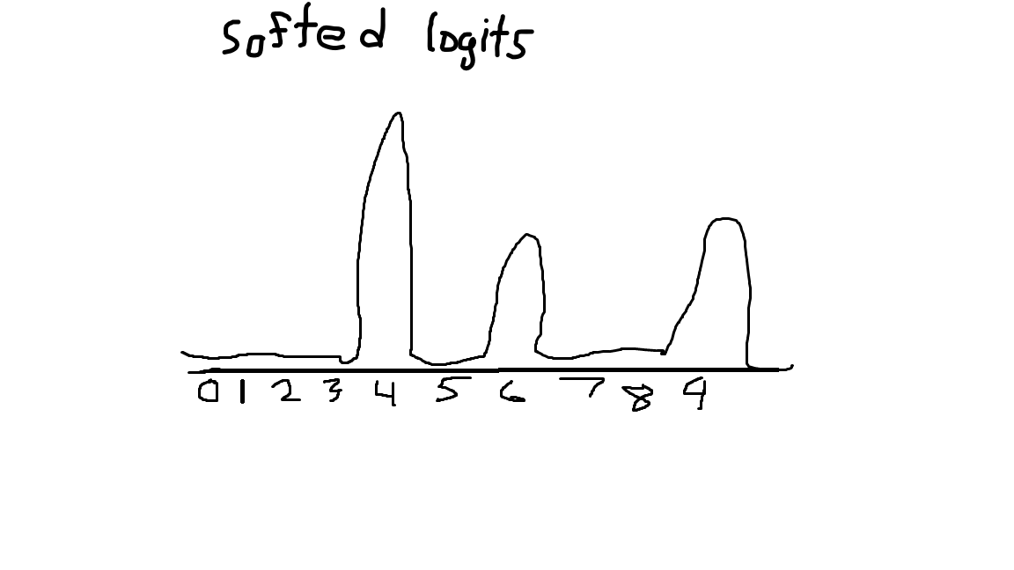
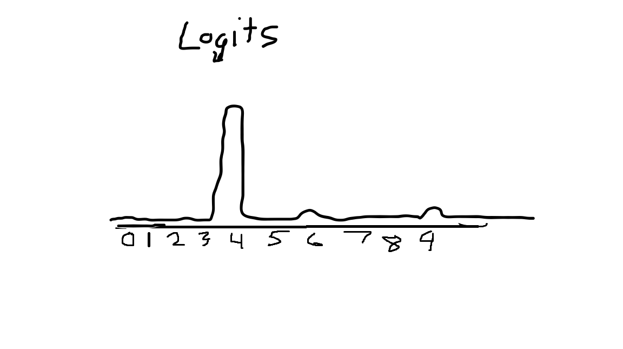
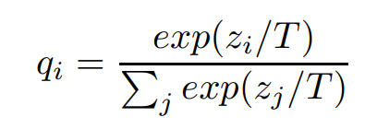
Temperature

Slide 8
Hybrid Loss
Soft loss: logloss(softed_teacher_logits, softed_student_logits)
Hard loss: logloss(y_true, y_pred)
Hybrid loss: soft_loss + hard_loss * x
* Also multiply soft loss gradients by T² to account for 1/T² shrinkage (Tips?)
Notes:
Where the contribution of the hard loss is much smaller than soft loss

Slide 9
Experiments on MNIST
Student
Teacher
2 hidden layers of 32 units each
2 hidden layers of 128 units each
275 errors on MNIST (97.25% acc)
Regularization
Dropout
Weight constraints
Trained on shifted images

Slide 10
Results
 | Teacher | Student | Student (distilled)
MNIST Test Errors | 275 | 528 | 454
Notes:
* Different initial and distilled training schedule

Slide 11
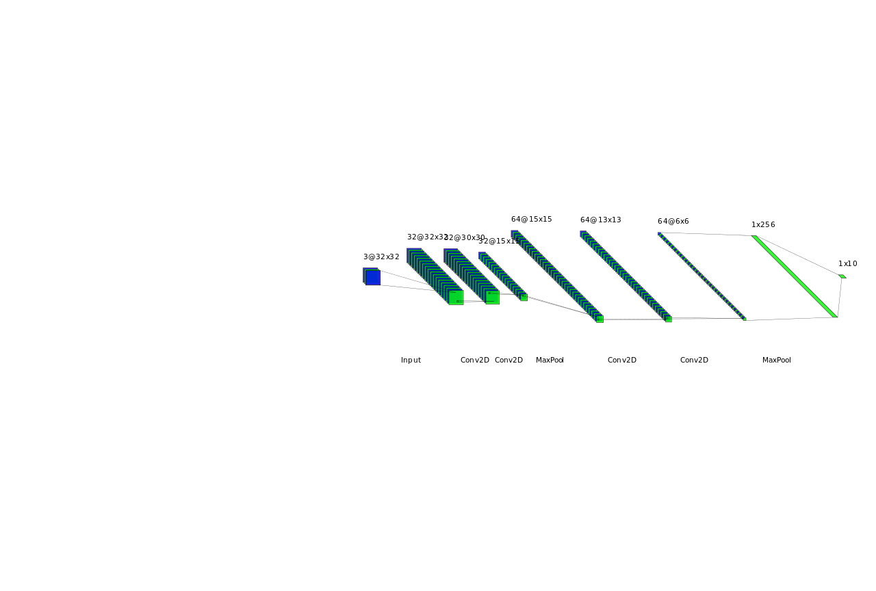
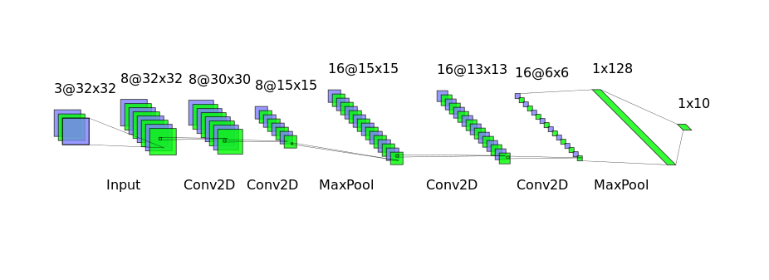
Experiments on CNN
Teacher
Student
Accuracy: 82.2%
Accuracy: 67.5%
Notes:
Dataset: cifar10
Will replace with better visualizations

Slide 12
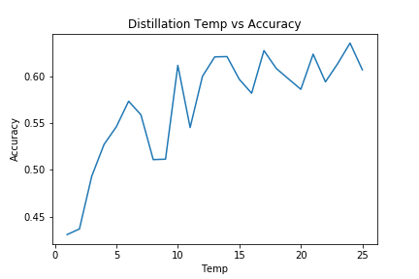
Experiments on CNN

Slide 13
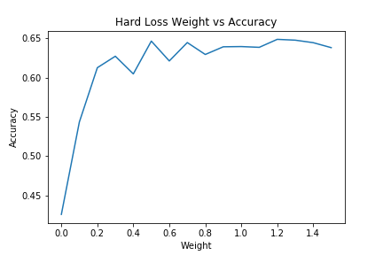
Experiments on CNN

Slide 14
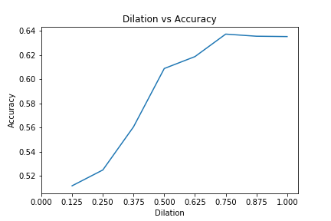
Experiments on CNN

Slide 15
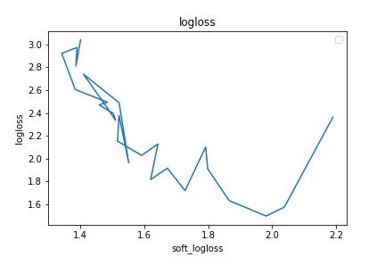
Experiments on CNN

Slide 16
Resources
https://github.com/Ujjwal-9/Knowledge-Distillation

